Slide 1
Big mountain resort
Pricing Recommendations based on Predictive Modelling

Slide 2
Problem identification
Additional chair lift increased operational costs by $1,540,000 this season
Big Mountain needs to increase ticket prices or reduce operational costs to cover added cost
The resort wants to update its pricing by analyzing competitor data instead of using market average
PROBLEM STATEMENT: Big Mountain wants to amend its pricing strategy to better monetize the facilities it offers compared to its competitors, by increasing ticket prices and/or reducing operational costs.

Slide 3
Recommendation & key findings
Big Mountain is in top 90% for key facilities compared to competitors
The resort is currently underpricing its weekend tickets by $4 - $24
RECOMMENDATION: Big Mountain should increase weekend ticket prices by at least $4 per ticket this season (from $81 to $85)
RECOMMENDATION: Big Mountain should close one (1) of its least popular runs to reduce operational costs, at no effect to pricing

Slide 4
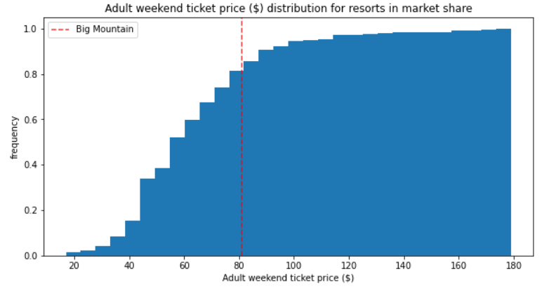
Results & analysis
Predictive model determined a weekend ticket price for Big Mountain of $95 +/- $10
Current ticket price: $81 / 80th percentile

Slide 5
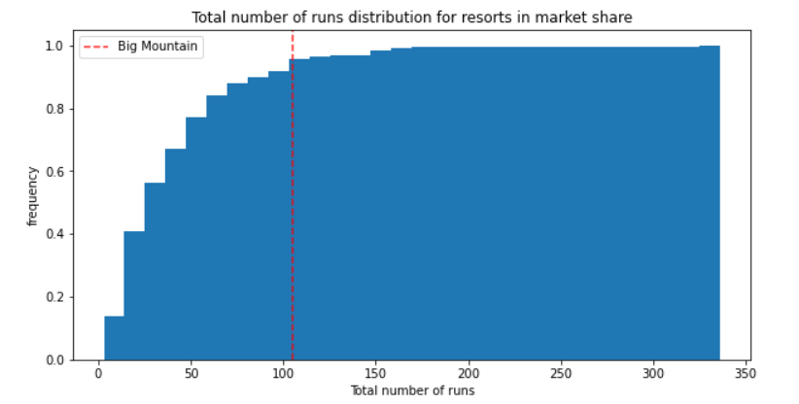
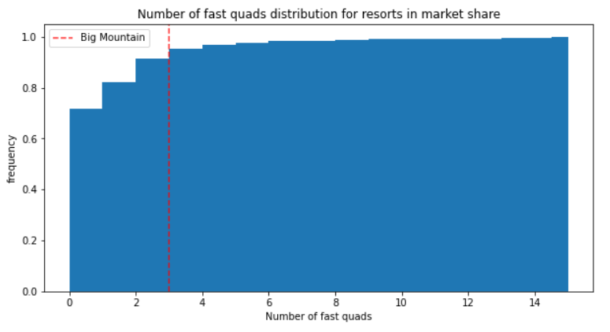
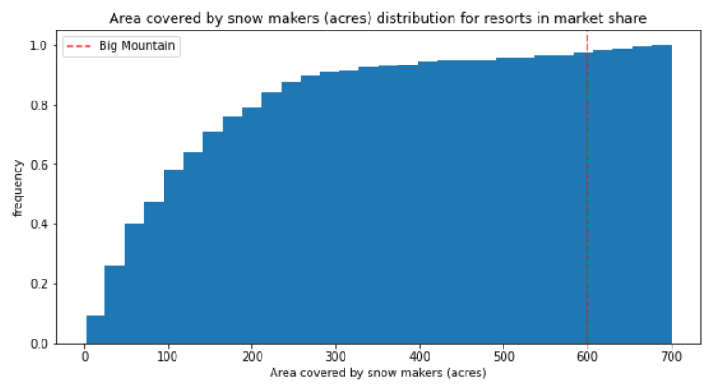
Results & analysis
Big Mountain key features: 90th+ percentile
Notes:
The position of Big Mountain on key features that determined ticket prices shows that Big Mountain is currently underpricing its weekend tickets based on the facilities it offers. A price increase is therefore justified for the resort.

Slide 6
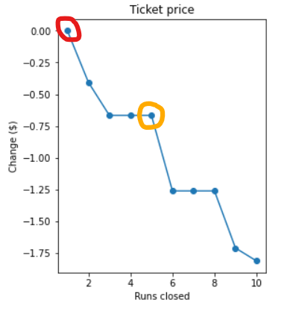
Results & analysis
OPERATIONAL COST REDUCTION:
Shut down (1) least popular run with no effect on pricing
Shut down (5) least popular runs at -$0.70/ticket

Slide 7
Results & analysis
LONG TERM INVESTMENT:
Increase vertical drop by 150 ft at +$2.00/ticket
New chair lift increases cost by $0.88/ticket
Further analysis required to determine additional operational costs

Slide 8
Summary & conclusion
Big Mountain is underpricing its weekend tickets
The resort is ranked in the top 90% for facilities it offers, compared to those of its competitors
Predictive model recommends a price increase of at least $4/ticket
Operational costs could decrease by shutting down the least popular run

